Slide 1
Horse Member Meeting
Douglas County 4-H
2024
Presented by:
Douglas County 4-H Horse Steering Committee
Douglas County 4-H Extension

Slide 2
INTRODUCTIONS
Horse Steering Committee Members
Mercedes Glenn – 4-H Extension Agent, Ex-Officio Member
Katy Dane – Horse Steering Committee President
Lindsay Griffith: Horse Superintendent - Cherry Valley Aggies
Andrea Slattery: Horse Superintendent - DC Aggies
Deb Bort, Roisin McEwen - Sedalia Spurs
Dawn Arnt – Clover Clan
Ross Ritter, Ashley Rodgers – Paddock Posse
Renee Paulsen, Gretchen Rierson - Cowboys
Elaine Marion - Cherry Valley Renegades
Julie Schmidt - Cowboys

Slide 3
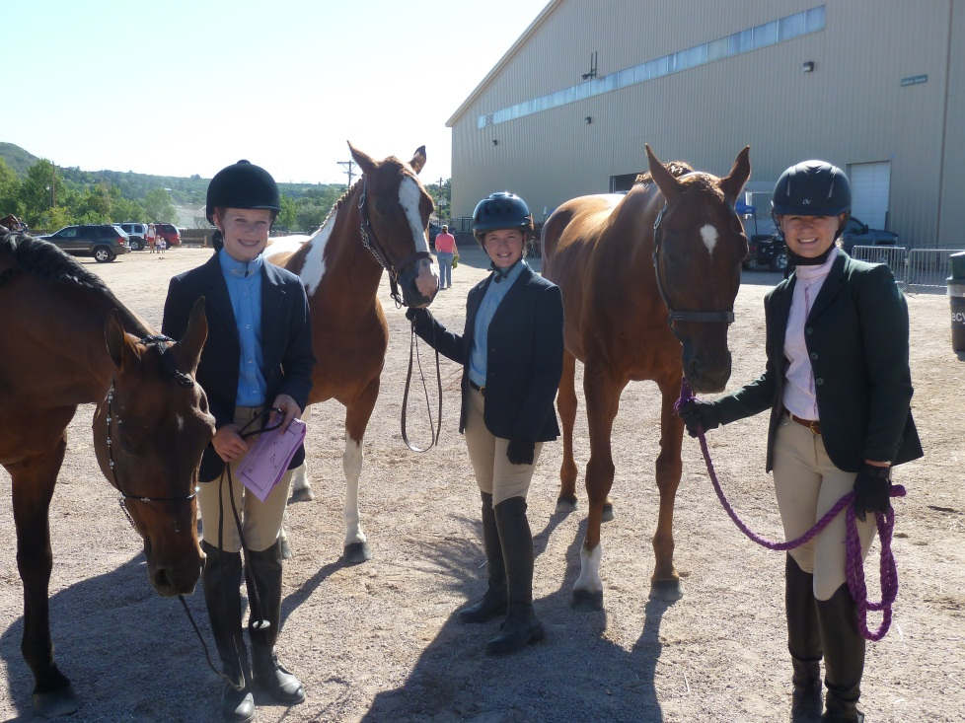
OVERVIEW
Program Requirements
4-H Levels Program
Miniature Equine
Resources to Help You
Additional Opportunities

Slide 4
PROGRAM REQUIREMENTS
1. Horse ID’s & Care/Housing Forms
Horse ID forms - Due APRIL 1st
Online via 4HOnline
Ownership documents (brand inspection) or lease agreement
Level Testing
Level testing (written and riding) must be completed by July 15
Required if wanting to show in classes that require a Level 1 or higher, or to compete at State Fair at a specific Level.
Written testing can be done at the Extension Office (by appointment only) or at the Written Study Test & Testing night. Riding tests can be completed at your (and the raters) convenience. Raters can be found here: https://co4h.colostate.edu/horse-resources/levels-testing/
Care and Housing Form –First page is incorporated into 4Honline.
Mandatory of all animal project youth
If horses are kept at home –only the first page is needed
If horses are kept elsewhere – Also, please fill out the second page
Notes:
Pass out Flyer—how to ID a horse in 4H online
Care and housing forms should be done already…Pass out hard copy to anyone who needs it (this is hard copy only…not available in 4H online

Slide 5
PROGRAM REQUIREMENTS
2. Rules/Regs and Code of Conduct
Acknowledges understanding of rules and regulations for participation in Horse Project and County Fair Horse Show
Includes show ring ethics and 4-H Code of Conduct
Due April 1st
Notes:
Pass out Flyer—how to ID a horse in 4H online
Care and housing forms should be done already…Pass out hard copy to anyone who needs it (this is hard copy only…not available in 4H online

Slide 6
PROGRAM REQUIREMENTS
3. Record Books
Download Record Books Online
http://co4h.colostate.edu/program-areas/animals/
Start Date for 1st year members is October 1, 2023
Start Date for returning members is the day after you turned record books in the previous year (September 1, 2023 for returning members)
Record Books for all youth participating in Fair will be checked on or before the Fair Written Test night.
START EARLY AND UPDATE OFTEN!
Your Record Book must be at least 50% complete to show at Fair
Record Books DUE to Leaders in August and then due to the Extension Office in September (Copy of Horse ID and Lease Agreement must be included in Record Book)
Miniature Horse members will use the Horse Project Record Book
Keep an eye on the blast for record book workshop opportunities

Slide 7
PROGRAM REQUIREMENTS
4. Legal Tack
Riders must show in legal tack at our Buckle Series, all 4-H shows, County Fair, and State Fair
Helmets with chin strap are encouraged in all events, but REQUIRED for Gymkhana and English activities and events
Legal tack varies according to discipline and the rules can be found in the 2024 4-H Rulebook
https://co4h.colostate.edu/program-areas/animals/
Make sure you check your equipment and look at the rulebook before you show or before you shop!
Ask questions often and early! We are here to help.

Slide 8
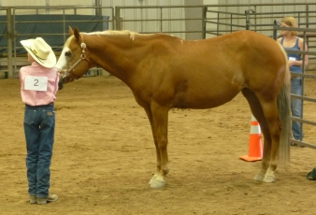
PROGRAM REQUIREMENTS
5. Showmanship
Members must show their horse “in-hand” (showmanship) at least one time to complete their project.
Most preferred way is at County Fair but can be done to your project leader, club leader, or Extension Agent

Slide 9
PROGRAM REQUIREMENTS
6. Requirements for Showing at County Fair*
*Showing at the Fair is not a project requirement
Competition Rules - Rule A, #1 under Showmanship: Failure to participate in the showmanship class of the Junior Division Exhibitor’s riding discipline will make the Junior Division Exhibitor ineligible to participate in any additional classes in that riding discipline and the Member in Good Standing statues will be revoked.
The 4-H Fair Horse Show has 3 age divisions: Junior (8-10), Intermediate (11-13) and Senior (14-18). Your 4-H age this year is your age as of December 31, 2023
Must complete County Fair entries by mid-June – GET A SCREENSHOT!
Be sure to sign up for ALL classes you are interested in. We can drop classes up until the Written Test Night – But we CANNOT add them after fair entries closes.
Ex: if you are wanting to test for Level 1 but are unsure if you will be able to pass the written or riding tests, sign up for walk/trot and Lope/Canter classes!
Notes:
Entry deadlines are TBD
2017 Jr. Horse Rules are not yet available

Slide 10
PROGRAM REQUIREMENTS
6. Requirements for Showing at County Fair*
To show in walk/trot/lope or canter classes at Fair, members must have passed the Level 1 written test (80% or higher) and the Level 1 riding test in their chosen discipline. If Level 1 not passed the member is only eligible for showing in walk/trot classes BUT YOU MUST HAVE SIGNED UP FOR WALK/TROT.
Members must be Level 1 Working Ranch Horse to enter the WRH classes at Fair
Members must be Level 1 Western to enter Gymkhana classes at Fair
Members must be "Jumping Approved” to enter the Hunt Seat Equitation Over Fences
Division High Point Eligibility: Showmanship, Horsemanship/Equitation, Horse Test
Notes:
July 1 deadline also applies to goat tying and jumping competencies

Slide 11
PROGRAM REQUIREMENTS
6. Requirements for Showing at County Fair*
Horse Written Knowledge Test Night: July 16th
This is a separate night from Livestock Tests
Test will be taken in indoor arena. Bring your horse to ride after the test and enjoy dinner. This will be your last chance to ride in the arena before the County Fair!
Record books must be checked and be 50% complete to enter participate in Fair
It is YOUR responsibility to check all classes for accuracy on this evening and this is the last chance to drop classes.
Notes:
July 1 deadline also applies to goat tying and jumping competencies

Slide 12
PROGRAM REQUIREMENTS
Requirements For Project Completion
Be a member in good standing
Know the Douglas County 4-H Policies for Success
Attend 60% of Club Meetings
Participate in project and/or project meetings.
Complete Showmanship to you Club Leader, Project Leader, Extension Agent, or at County Fair
Complete your record book to 70% or better, receive club leader signature, turn in by the date published to receive completion.
***If you do not complete your project, you will not be allowed to do that project for one year.
Notes:
July 1 deadline also applies to goat tying and jumping competencies

Slide 13
Colorado State Fair
Showing at Colorado State Fair
Will not show specifically by levels at CSF this year.
More information will be coming out regarding these changes – please watch for more information.
Will show my ages
Level 1 will be allowed to show in some classes this year.
Miniatures will show on the last day of the CSF Horse show.
Thursday - English, Friday - Western, Saturday - Ranch, Sunday- Miniature Horses & Gymkhana will be the order of show.
Notes:
July 1 deadline also applies to goat tying and jumping competencies

Slide 14
4-H LEVELS PROGRAM
1. Where do we start!?!
All new members are “unrated” or “unleveled” regardless of prior experience
There are 4 levels within each discipline **This will be changing next year. Be prepared.
Disciplines Offered:
Western
Working Ranch Horse
English
Hunt Seat, Dressage, Saddle Seat
Notes:
NOTE: Has anyone transferred from another county and is already leveled?

Slide 15
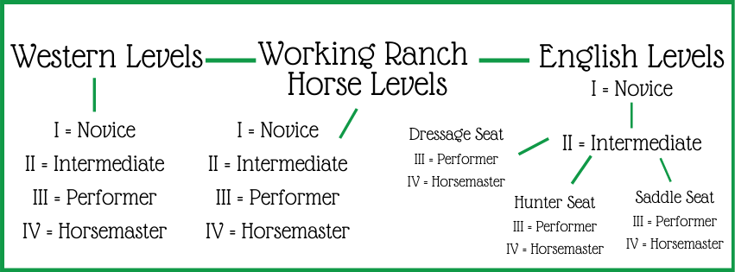
4-H LEVELS PROGRAM
2. Disciplines Offered *This will be changing next year
Notes:
Pass out riding tests for different disciplines

Slide 16
4-H LEVELS PROGRAM
3. Written Tests
Written tests are the same for all disciplines. The level one written test has 2 sections of tack ID—English and Western. You must take both!
All written tests (including level one) must be taken at the Extension office, or during written test study and testing night. No cell phones allowed during test.
Tests can be taken multiple times (not on the same day) until the member passes with an 80%
Completed tests cannot be taken home
It is recommended that you take the written test before the riding test.
Come to the review/testing session offered February 21st.
Notes:
Pass out review sheet for different levels
Pass around sign up sheet for review/testing session

Slide 17
4-H LEVELS PROGRAM
4. Raters for Level 1
You must take your Level 1 riding test with a county approved rater (previously introduced).
Riding tests are usually done one discipline at a time.
Once you have passed your written test, call the Extension office and we will connect you with a Level 1 rater for your riding test.
Notes:
WRH change is a state change that our county also adopted

Slide 18
4-H LEVELS PROGRAM
5. Advancing through levels
Can I become leveled in more than one discipline?
Yes, and many 4-Hers are at different levels in different disciplines. Once you pass the written test for any given level, you can begin working on the riding tests for as many disciplines in that level as you want.
What is on the test!?!

Slide 19
4-H LEVELS PROGRAM
5. Advancing through levels
Can I pass multiple levels in one year?
Yes; it is tough, but definitely possible. This is important for kids who only want to show in Gymkhana or WRH.
How do I find a rater for levels 2 through 4?
Laura Jordan, Katy Dane and Andrea Slattery are our only raters in the county for levels 2 through 4. You can find a list of additional state approved raters online.
Week of Horse Camp - Levels Testing Day at Fairgrounds – must register through Horse Camp
Notes:
Note: We will likely have a testing day at horse camp

Slide 20
Douglas County Buckle Series
Open Show Series: Feb 25, Mar 24, Apr 27, May 19, and June 15.
Douglas County Fairgrounds Indoor Arena
English, Western, Gymkhana
Age Groups and a Walk Trot Division
Series and Daily Highpoint Awards By Discipline
4-H Kids who attend this series are generally more successful at Fair.
Follow us on Facebook https://www.facebook.com/groups/2778681378850279/about
DC Extension https://douglas.extension.colostate.edu/4-h/programs-2/horses/

Slide 21
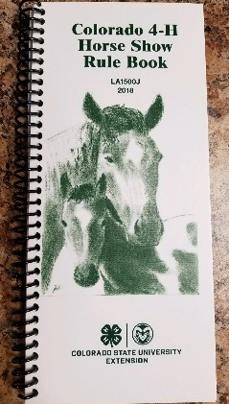
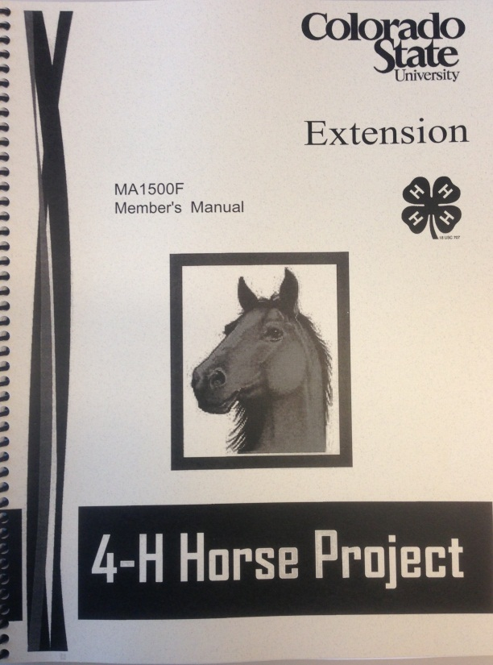
RESOURCES TO HELP YOU
1. Written and Online Resources
Make sure you download a Horse Manual and a Rulebook or(price TBA)
Douglas County Horse Project Guide and Rules
Douglas County Fair Rules
https://www.douglascountyfairandrodeo.com/p/exhibitors/competition-rules
Always read the Thursday Blast to make sure you don't miss important information

Slide 22
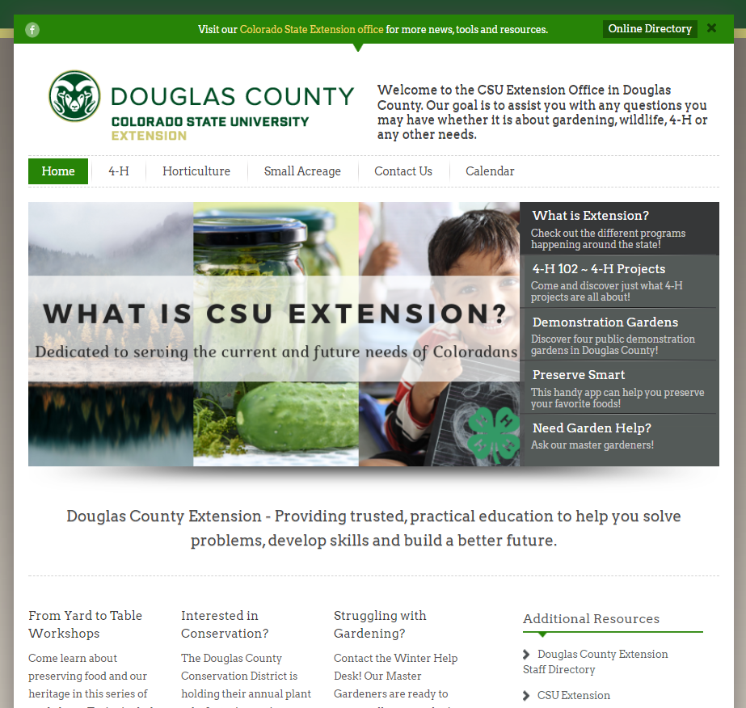
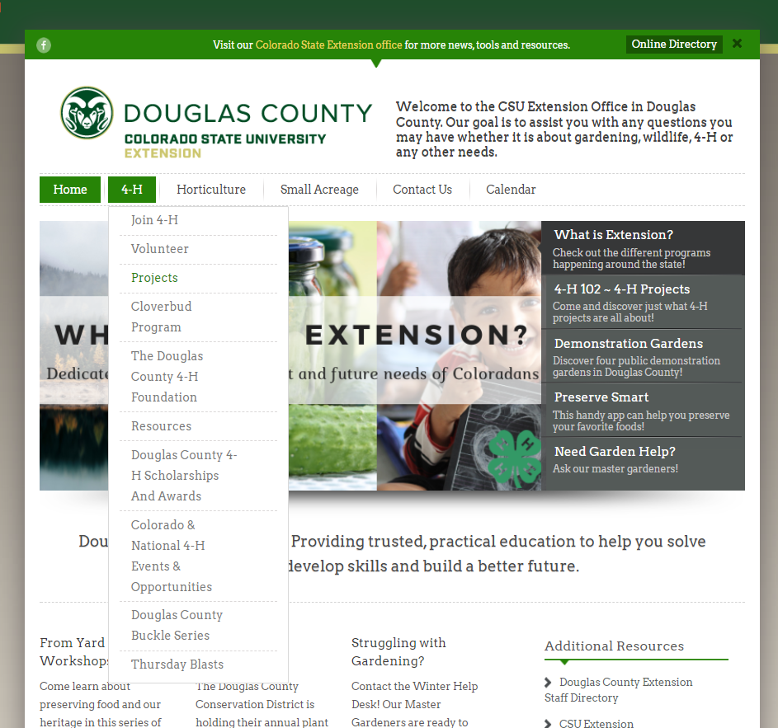
RESOURCES TO HELP YOU
1. Written and Online Resources douglas.extension.colostate.edu

Slide 23
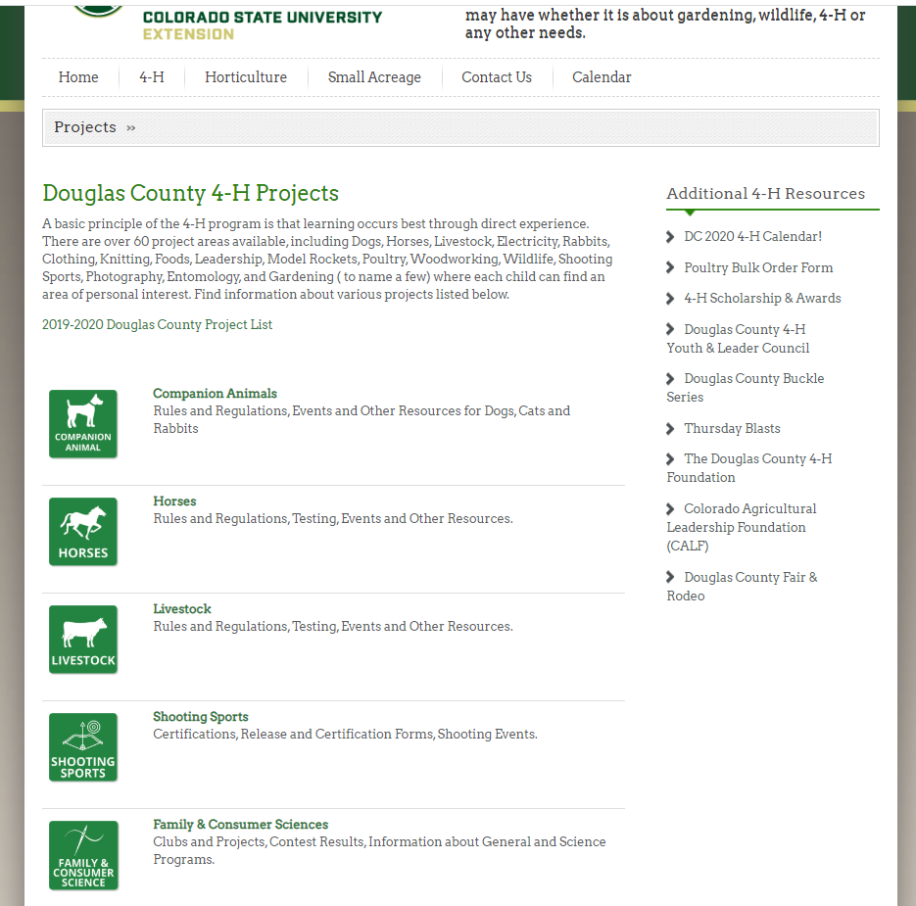
RESOURCES TO HELP YOU
1. Written and Online Resources douglas.extension.colostate.edu

Slide 24
RESOURCES TO HELP YOU
1. Written and Online Resources douglas.extension.colostate.edu

Slide 25
RESOURCES TO HELP YOU
1. Written and Online Resources douglas.extension.colostate.edu

Slide 26
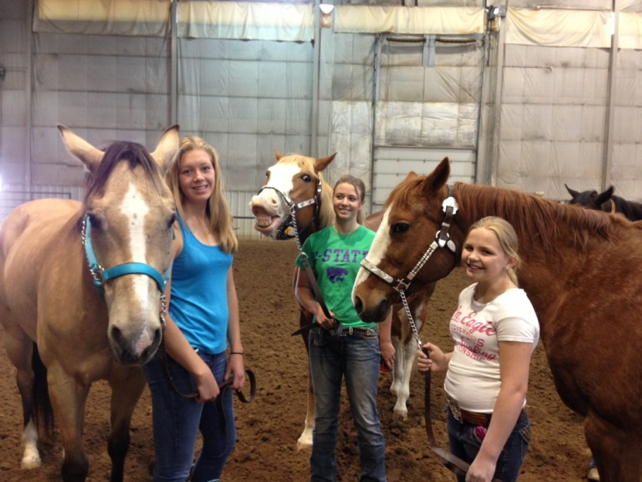
RESOURCES TO HELP YOU
2. Help with Horsemanship
Indoor Ride Nights (March, April, May) – more info to come! Be on the look out for RSVP’s! RSVPs are REQUIRED! If you have not RSVP’d you might not be able to ride.
Sponsored by DC Horse Advisory Committee
Monday night ride nights in the fairgrounds outdoor arena
Buckle Show Series - Great Practice for County Fair!
Contact: Katy Dane, Andrea Slattery, Lindsay Griffith
Horse Camp (June 10-14)
Contact: Lindsay Griffith, Andrea Slattery
Separate Working Ranch Clinic on Friday
Notes:
Handouts:
Monday night ride nights
Buckle Show: Showbills and entry forms
WRH Handout and sign up sheet
Horse Camp Handout
***If time, briefly discuss finding a horse that suits what you want to do. Handout looking for a first horse handout to anyone who wants one

Slide 27
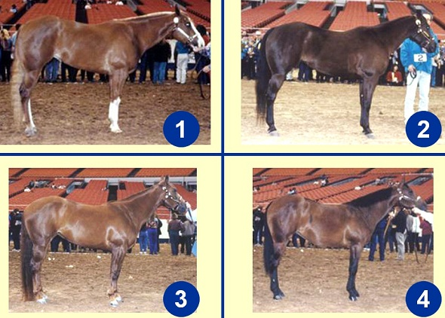
ADDITIONAL OPPORTUNITIES
Horse Written Test Study Night and Testing
February 21, 2024 please RSVP!
Horse Judging/Horse Bowl/Hippology
Contact: Mercedes Glenn Information night February 29th
Horse Steering Committee Meetings
Open to all members, parents and leaders!
Meets the 4th Monday of each month at 6:30 pm in the CSU Extension basement
Come help plan events and provide direction for the horse program in Douglas County!
Educational Horse Seminars
Held each month (unless cancelled) during the Horse Steering Committee meetings. Open to all youth and parents looking for more information.

Slide 28
MINI HORSE PROJECT
Miniature Horses/Donkeys are new for this year and have been approved to be at County Fair as well as the Colorado State Fair.
MUST be safety certified (only the first section) in order to show at County Fair.
Information will be coming out as it’s available.
Clinic held on April 6th
Able to show at Colorado State Fair
Attend clinics and shows!
Attend parades!
Let people meet your minis!

Slide 29
MINI HORSE PROJECT
Classes
Showmanship
In Hand Trail/Obstacle
In Hand Hunter
In Hand Jumper
In Hand Barrels
In Hand Poles
Costume Class
Looking to add Driving Classes next year!

Slide 30
QUIZ
What night is the Levels Testing Study Night?
What piece of equipment is required for both English and Gymkhana classes?
Do you have to own a horse to do the horse project?
When is the Horse ID deadline?
What class do all 4-H Horse contestants have to compete in at County Fair?
What is required for Project Completion?

Slide 31
THANK YOU!!!
Please help us clean up chairs and tables :-)
Feel free to stay and ask any specific questions you may have!
Colorado State University Extension
programs are available to all without
discrimination.
Notes:
Pass out project guides

